Slide 1

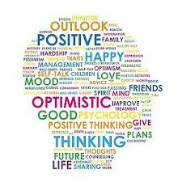


Slide 2
Self isolation for CORONA-V
Self isolation and how this is impacting your mental health
What barriers are you facing at this current time?
How are we able to adapt and overcome?

Slide 3
Self isolation for CORONA-V
Do you feel lonely?
Do you feel unwell?
Have you lost people to the pandemic? Are you able to say goodbye?
Can you get out into nature?
Do you have any support system? Family / Friends / Social networking online / utalising resources?

Slide 4
Stay connected
Connecting with others:
Phone call/message or video to family and friends
Video chat with family and friends
Start a pen pall / email pal relationship as we are all going through the same trials rite now.
Shared interests to talk about i.e. show have watch or book have read, pre plan so that you are able to have time out period and discuss what you thought about it
Online clubs or forums to talk to others and share a common theme or interest
STITC online quiz nights and services
Notes:
Kay to conducted. Banners at the bottom of the screen.

Slide 5
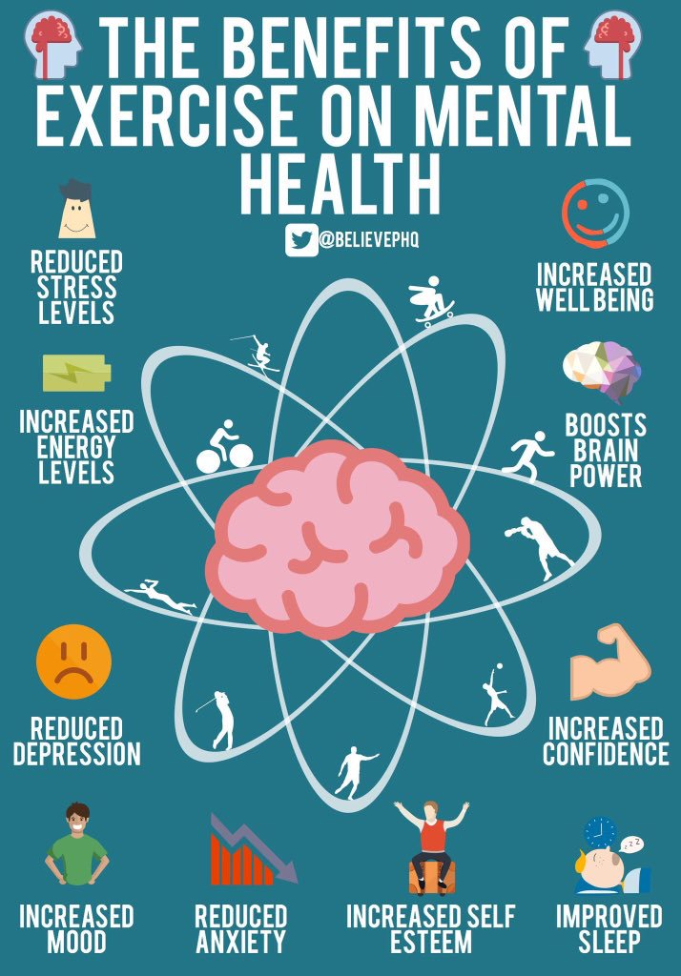
Exercise
Make sure you take your exercise each day of lockdown!!!!
Notes:
Omar to talk about the benefits of exercise and why ‘Healthy body=Healthy mind!!’

Slide 6
Exercise
Build physical activity into your daily routine, if possible. Exercising at home can be simple and there are options for most ages and abilities, such as:
  Clean your home
  Dance to music
  Go up and down stairs
  Online exercise workouts that you can follow
  Seated exercises
  Sit less – if you notice you’ve been sitting down for an hour, just getting up or changing position can help.
  Set exercise challenges or have a calendar you can tick off each day
Notes:
Omar can you speak about how you put exercise into your daily routine and how beneficial it is to you?!
Group work outs with other players/friends? Connecting with people as exercising.
Do your family get involved in your routine?

Slide 7
Ways to relax……
Arts and crafts, such as drawing, painting, collage, sewing, knitting, craft kits or upcycling
DIY
Mindfulness
Playing musical instruments, singing or listening to music
Writing or journaling
Yoga / Meditation / Pilates
Computing/Gaming
Notes:
Ryan to ask all how we are using are down time to relax during a difficult period such as this.
Ask Kay how parents main objective during this time isn’t how much school work you are able to email the teacher, but keeping are children safe and well and using this time to bond and share, to play and be a family in whatever dynamic that may come in.
Can Kay talk through a simple technique of how to talk about feeling with your children, or activities that can do this without talking about it.
How parents are the role models of building resilience in children, it is not always an innate trait it is in fact learnt.

Slide 8
Anxiety
Anxiety can be helpful:
Motivates and prepares us to complete something we would not normally do – Fight or flight response
Anxiety is normal feeling that happens to us all.
This is a signal to slow down and refocus
This is how your body keeps you safe
My mind is protecting me by setting limits
The feeling is temporary and will pass
Notes:
Kay and Sophie to talk through the feelings of stress and anxiety and how to use the techniques that follow.
Stress is normal but how we recover from a stressor, using techniques and use of mindset, is the difference between becoming overwhelmed or having the ability to refocus and deal with said stressor.

Slide 9
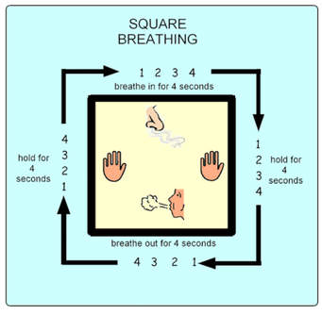
Box Breathing technique
This box breathing / Window technique is used by yogis, Navy Seals, police, first responders, and high performance athletes to calm the breath and focus the mind because it is such a powerful stress reliever.
Notes:
Simple techniques if need to calm breathing and relax when feeling overwhelmed.
By stabalising your breathing, it lowers your heart rate, blood pressure drops or stabilises, and in turn your muscles relax.

Slide 10

Traffic light technique
Focus on slow breathing (utalise the box technique). Notice what you are thinking, feeling and doing.
Don’t try to control your worries………let them be there and realise they will not harm you.
Watch the feeling go by imagining it drifting away from you. Focus on a small task in front of you and what you can control rite now.
Red
Stop
Amber
Wait
Green
Go

Slide 11

5 Senses Grounding exercise
5 Things that you can SEE
4 things you can FEEL
3 things you can HEAR
2 things you can SMELL
1 thing you can TASTE
Notes:
To stop a panic attack this is a good grounding technique

Slide 12
Adjust your focus
The Hallmark of depression and anxiety is catastrophizing (thinking something is far worse than it is) – worrying about something that has not happened yet and may not happen at all. Worry by its very nature means thinking about the future – however if you focus on the present here and now worry will melt away.

Slide 13
Wellbeing Top Tips
Sing in the shower
Play with your family pets
Have a good nights sleep
Spend some time with family and friends via video chat
Listen to your favourite music and make a play list
Read a good book
Watch a great TV show/Movie
Eat something delicious
Do some exercise
Stay hydrated
Draw a picture
Laugh until your cheeks hurt – share jokes with family and friends
Spend some time in the fresh air
Dance
Notes:
I have a well-being bingo handout for this to go out as a resource. Fun way for the family to check they have used there time to stay well.

Slide 14
Helpful resources:
Crisis and emotional support:
Samaritans – 116123 (freephone, 24 hours a day, 7 days a week) www.Samaritans.org
Mental health information helpline:
Rethink advice and information service – 0300 5000 927 (local call rates, 9.30am-4pm). Provides practical advice on issues such as the Mental Health Act, community care, benefits, debts, criminal justice and carers’ rights.

Slide 15
General Mental Health:
Mind. 0300 123 3393. www.mind.org.uk.
Mind provide services relating to mental health, information and support. Mind is an umbrella organisation for independent local Mind organisations, which provide different services across the country.

Slide 16
Anxiety
Anxiety UK – 08444 775 774. Txt 07537 416 905. www.anxietyuk.org.uk.
No Panic – 0844 967 4848. www.nopanic.org.uk.
Depression UK – www.depressionuk.org
PANDAS Foundation – 08432898 401. www.pandasfoundation.org.uk.

Slide 17


Self Help Resources
Happyhealthy. www.happyhealthyapp.com.
Headspace.
www.headspace.com

Slide 18
CBT Online – www.moodgym.anu.edu.au.
Big White Wall – www.bigwhitewall.com.
Elefriends – www.elefriends.org.uk.
FearFighterTM – http://fearfighter.cbtprogram.com.
Sleepio – www.sleepio.com.
Moodpanda – www.moodpanda.com.

Slide 19






Being tested in the NHS
Use breathing techniques to help you relax more, worry less and feel better
Free
MeeTwo
A safe and secure forum for teenagers wanting to discuss any issue affecting their lives
Free
Catch It
Learn to manage negative thoughts and look at problems differently
Free
distrACT
Quick and discreet access to information and advice about self-harm and suicidal thoughts
Free
Calm Harm
Reduce urges to self-harm and manage emotions in a more positive way
Free
eQuoo: Emotional Fitness Game
Use adventure games designed by psychologists to help you increase your emotional fitness
Free, with in-app purchases

Slide 20



Stress & Anxiety Companion
Breathing exercises, relaxing music and games to help calm your mind and change negative thoughts
Free, with in-app purchases
SilverCloud
An eight-week course to help you manage stress, anxiety and depression at your own pace
Free
My Possible Self: The Mental Health App
Learn how to manage fear, anxiety and stress and tackle unhelpful thinking
Free, with in-app purchases

